Slide 1
Food and Beverage Management fifth edition
Chapter 8
Events, Conferencing and Banqueting

Slide 2
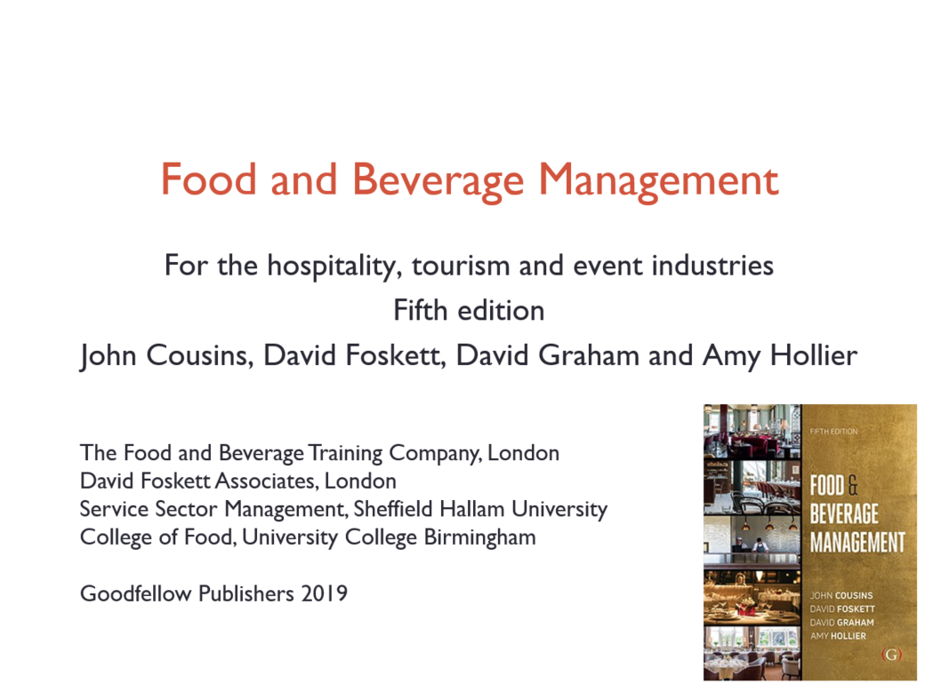

Slide 3
Chapter 8 covers:
Structure of the events sector
Sales and marketing
Staffing considerations
Costing considerations
Managing the event process

Slide 4
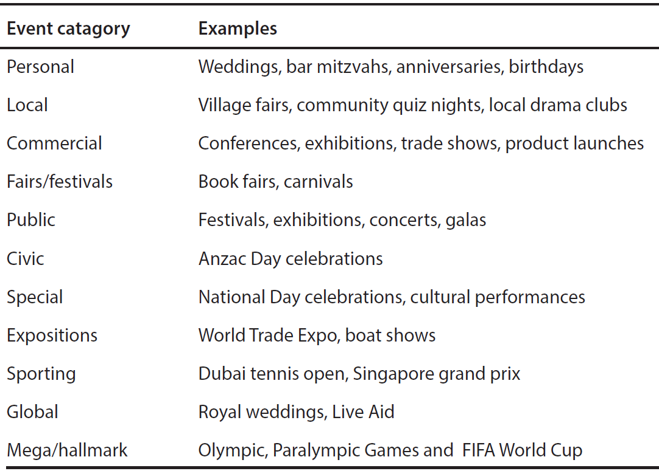
Event categories and examples

Slide 5
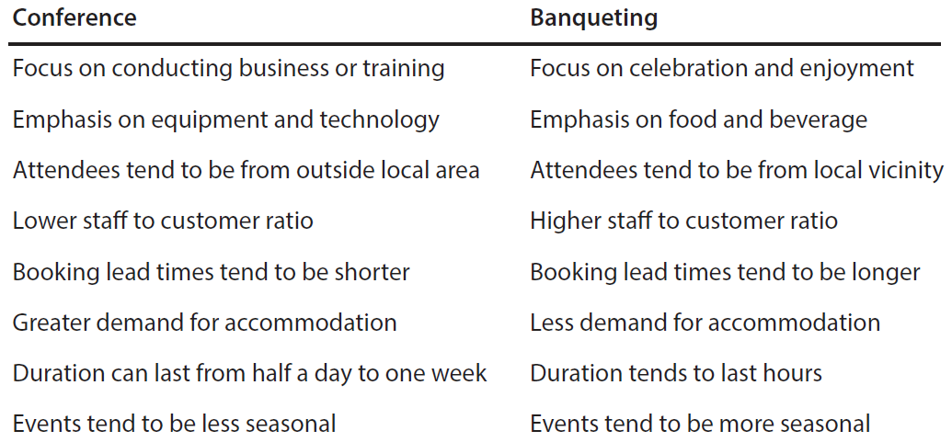
Comparison of characteristics

Slide 6
Examples of types of events
Congress
Exhibition/trade fair
Forum
Interview
Lecture
Meeting
Retreat
Road show
Seminar
Workshop
Off-premises

Slide 7
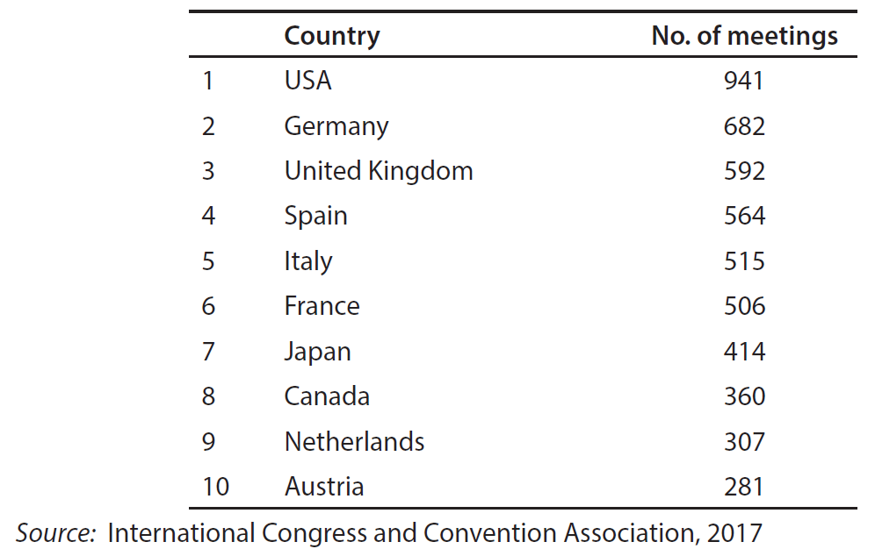
Top international meeting countries

Slide 8
Event management companies (EMCs)
Organise events on a contract basis on behalf of their clients
Services can include:
  Concept development
  Planning the event theme and decor
  Marketing and advertising and ticketing
  Screening venues
  Risk assessment
  Contracting entertainers, speakers and other artists
  Dealing with caterers.

Slide 9
Benefit of events
Utilisation of space and resources
Revenue stream
Potential to capitalise on national and local events
Can achieve high customer satisfaction
Savings through bulk food and beverage purchasing
Less food waste and reduced labour costs due to fixed menu and numbers

Slide 10
Potential challenges
Space perishability
Competitive environment
Large inventory of equipment to manage
Managing expectations of large numbers
Achieving satisfaction of large numbers
Managing causal labour
Management of AV
Multiple stakeholders

Slide 11
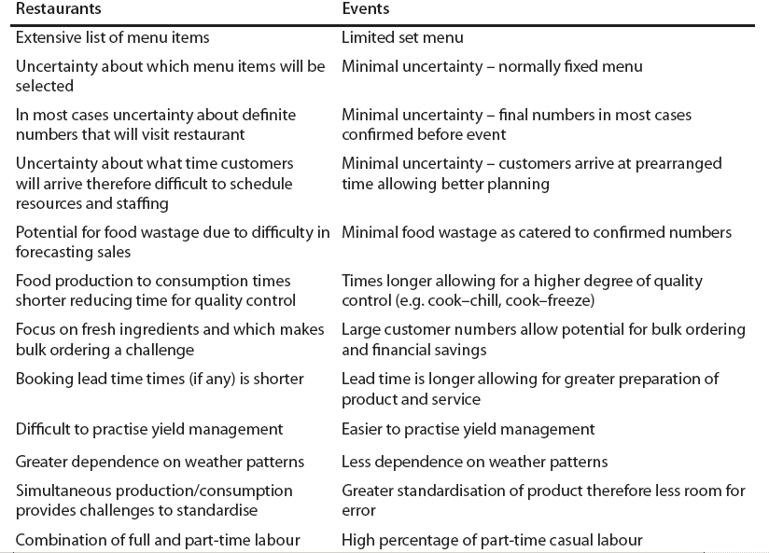
Restaurant and event operations

Slide 12
Sales and marketing
Activities include:
  Marketing of venue to different customer segments
  Maximising distribution channels and intermediaries
  Effective sales teams
  Event sales strategies

Slide 13
Event segmentation
Examples of event segments include:
  In-house customers
  Local businesses
  Local residents
  Corporate companies
  Charities or non-profit organisations
  SMERF Groups
  Trade and professional bodies
  Incentives market
  Exhibitions market

Slide 14
Maximising distribution channels
Examples of channels may include:
  Website
  Central Reservations System (CRS)
  Event/meeting planners
  Destination management companies (DMCs)
  Convention bureaus
  Web based software for meeting/events
  Accommodation and meeting booking sites

Slide 15
Effective sales teams
Sales personnel should be allocated specific targets
Monitoring may include:
  Number of telephone calls made
  Number of sales calls or presentations made
  Revenue achieved by sales person

Slide 16
Event sales strategies include:
Utilising efficient event-booking software
Applying effective sales techniques
Creating venue generated events
Developing high quality event collateral

Slide 17
Sales activities include:
Forecasting high and low demand periods
Maintaining reservation records and customer history
Forecasting net yield for event bookings
Awareness of segment booking patterns
Avoiding very advanced bookings
Enforcing clear cancellation procedures
Considering commissions for intermediaries

Slide 18
When demand is high:
Accept only full priced bookings
Don’t
  Let out part space bookings too far in advance
  Offering discounts or promotions
  Provide complimentary products or services
  Have out of order rooms or refurbishments

Slide 19
When demand is low:
Maximise spending of existing customers
Offer promotions and be prepared to negotiate
Creating venue generated events
Provide familiarisation for potential clients
Offer free space to local communities
Carry out internal quality audits and deep cleaning and routine maintenance

Slide 20
Example promotion activities
Embrace social media
Be known as sustainable
Email alerts
Encourage companion (linked) services
Promote loyalty

Slide 21
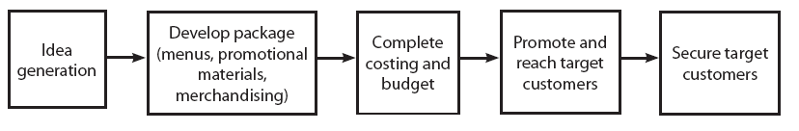
Creating venue events: the process

Slide 22
Event collateral
Includes:
  Logo of venue or establishment
  Contact information and location
  Information about the venue
  Floor plans, room setups and example menus
  Professional photographs
  List of products and services offered
  Pricing, including packages
  Reviews, classifications and awards

Slide 23
Other considerations
Outsourcing for services and products
White listing
Greening of events

Slide 24
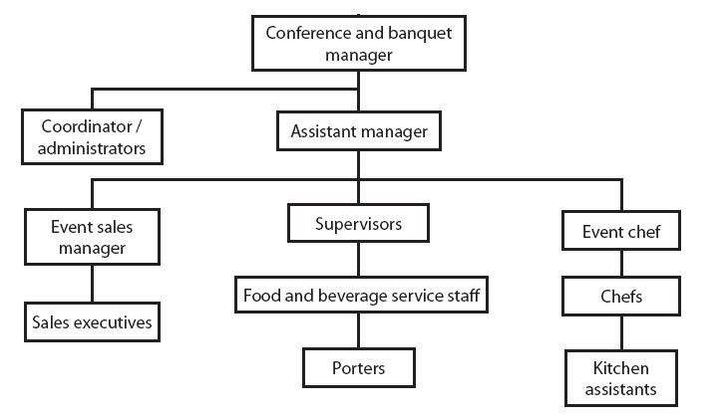
Example organisation chart

Slide 25
Staffing considerations
Some of the main skills and qualities required for any operator are:
  Welcoming and friendly approach
  Good personal presentation
  Flexibility in meeting customers’ needs
  Ability to sell products and services
  Planning and co-ordination skills
  Visible to staff and clients
  Hard working and creative

Slide 26
Costing
The cost of an event can be broken down into four main categories:
  Operational or production costs – including hiring of event staff, construction, insurance and administration
  Venue/site rental
  Promotion – advertising, public relations and sales promotion
  Talent – costs associated with entertainment

Slide 27
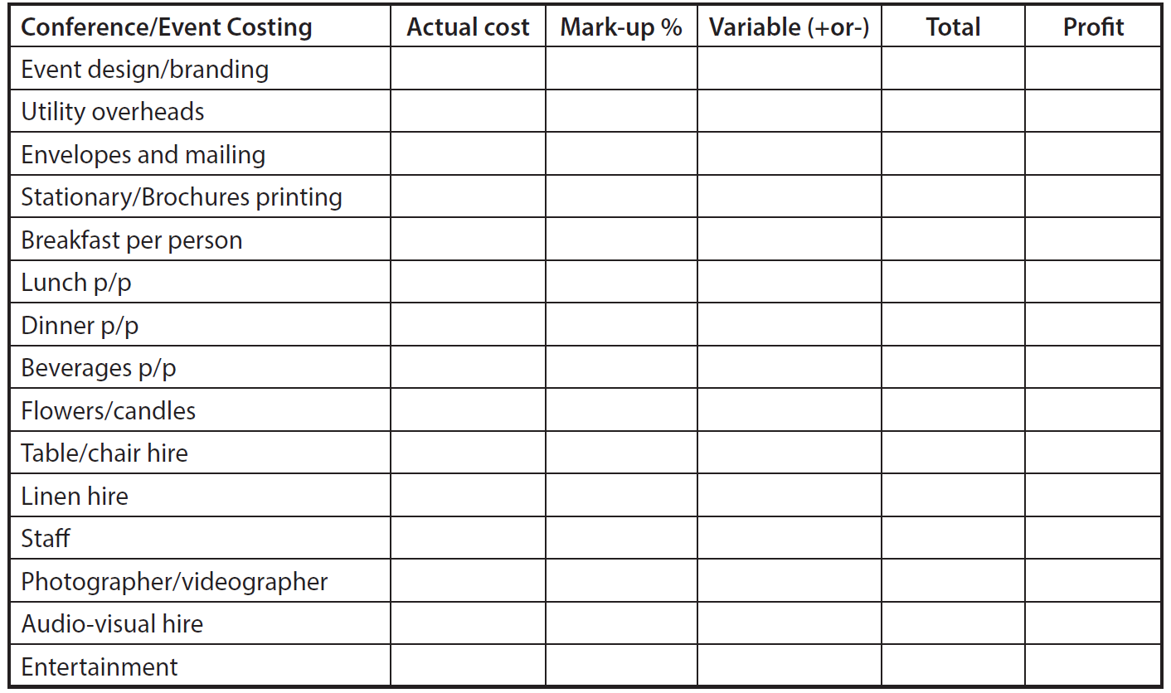
Example budget template

Slide 28
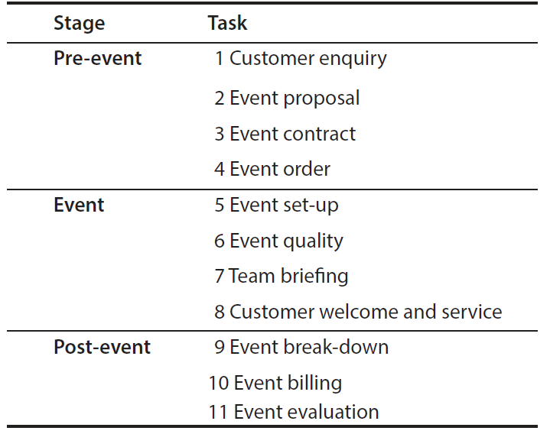
The event process

Slide 29
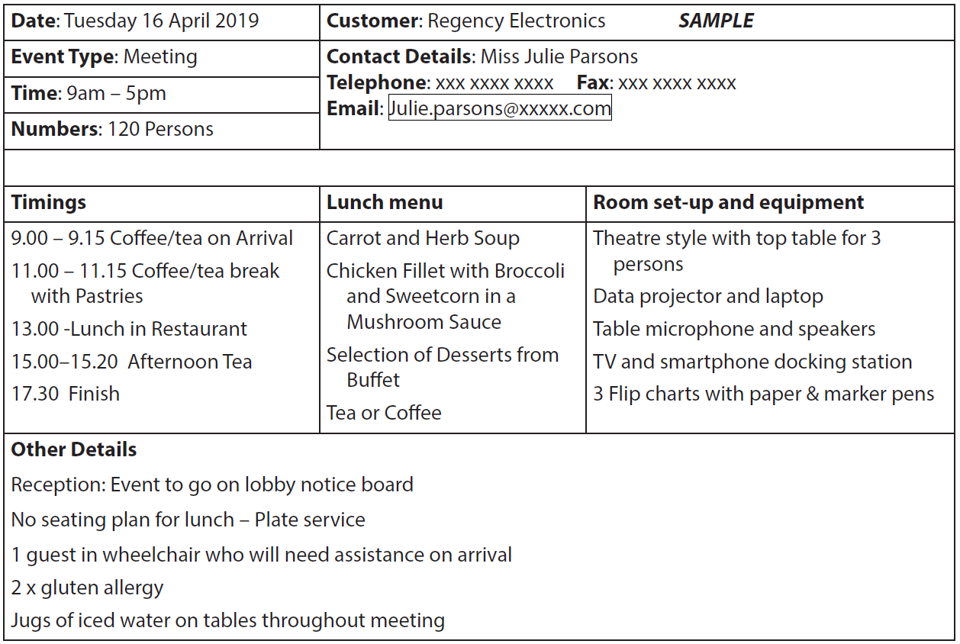
Example event order

Slide 30
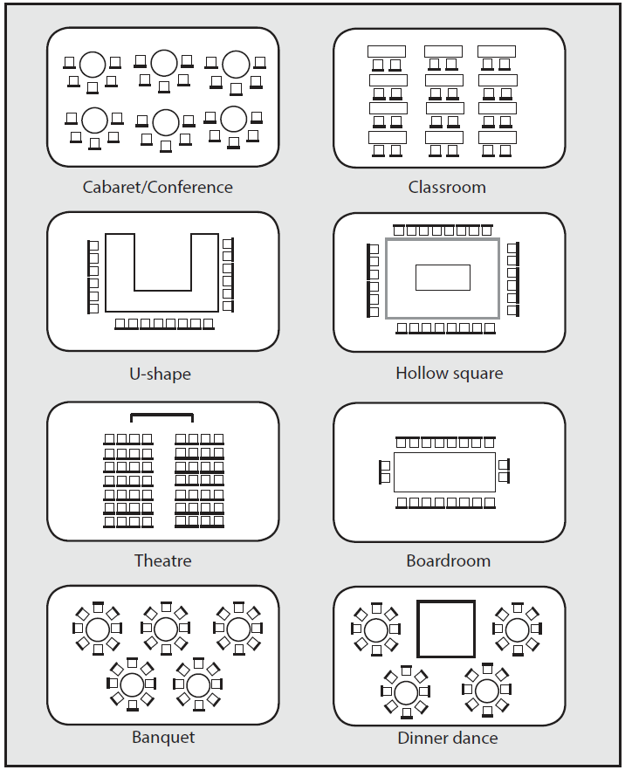
Example room layouts

Slide 31
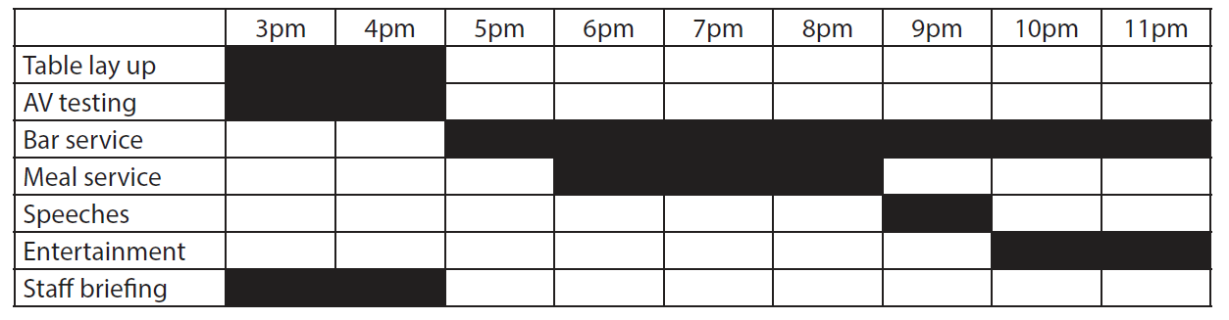
Example Gantt Chart

Slide 32
Banqueting: potential challenges
Menu design
Food safety
Food quality
Food and beverage timing
Flow of service
Diverse customer base
Intoxication
Event crisis planning

Slide 33
Conferences: Potential challenges
AV system and delivery
Having up to date information technology
Dealing with multiple contractors
Potential for additional revenues

Slide 34
Event evaluation is essential
Feedback from the customer
Feedback from team
Measure how the event performed against:
  planned budget
  event order
  departmental service standards
Keep records
Ensure remedial action is taken as necessary

